Slide 1

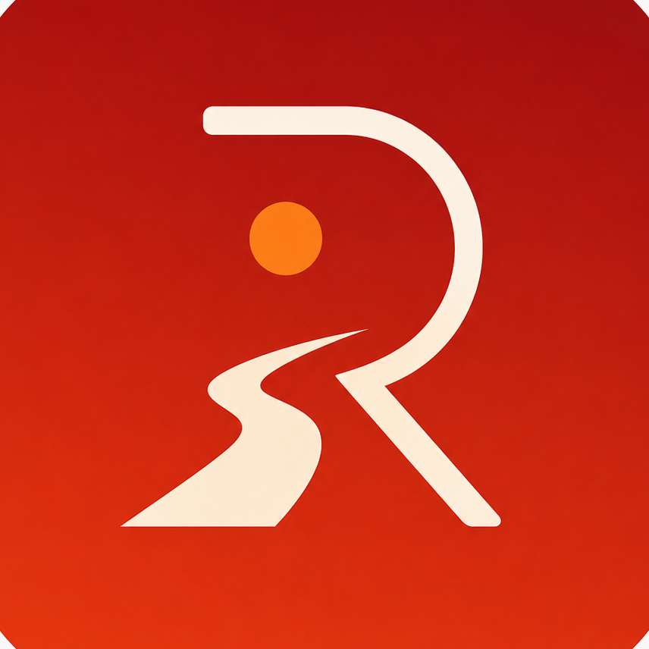

RedDust
Listen to the radio that listens to your soul
AI-Powered Personalized Music, Karaoke and Wellbeing Platform
Vision: Creating personalized music that understands the listener - to energize, refresh, motivate, relax and uplift
Concept:
Personalized AI RJ and wellbeing companion that creates programs, not just playlists
Adapts to mood, situation, age, language and preferences
Supports music, karaoke, ambience and wellbeing
Powered by Syan Bot

Slide 2
RedDust
Listen to the radio that listens to your soul
The Team
Mannat
Ajay
Soubhanik
Nathan
Sayan
Anirban
Background
Superpower
Fun Fact
Favorite App
Music Genre
Powered by Syan Bot

Slide 3
RedDust
Listen to the radio that listens to your soul
Why Anodiam?
AI-first product mindset
Startup speed
Senior-led engineering
Full-stack capability
Ability to scale from MVP to production
An UNSW Founders’ startup
Funding Strategy
Build MVP
Validate users and engagement
Apply through UNSW Founders ecosystem
Seek mentors and startup programs
Pitch to angel investors and VCs
Powered by Syan Bot

Slide 4
RedDust
Listen to the radio that listens to your soul
MVP/ Release One Features
Karaoke scoring
Mental wellbeing trends
Dynamic ambience + 3D visuals
Personalized memory layer
Family modes
AR / smart glasses integration
Future Releases
User profile and preferences
Mood-based playlist generation
Local + online playback
Child-safe filtering
Smart recommendations
Voice commands
Basic Syan interaction
Powered by Syan Bot

Slide 5
RedDust
Listen to the radio that listens to your soul
Closing Discussion
What excites you most?
Top 2 MVP features?
Risks and ideas?
Next steps
Powered by Syan Bot

